Slide 1



Digital Design Primer
FPGA/Verilog from Scratch
DAY 1

Slide 2
Outline
Digital Systems
Binary Numbers
Number-base Conversions
Signed Numbers
Binary Logic

Slide 3
Digital systems
Analog Systems
The physical quantities or signals may vary continuously over a specified range.
Digital Systems
The physical quantities or signals can assume only discrete values.
X(t)
X(t)
t
t
Analog signal
Digital signal

Slide 4
Binary Numbers
n | 2^{n}
0 | 2⁰=1
1 | 2¹=2
2 | 2²=4
3 | 2³=8
4 | 2⁴=16
5 | 2⁵=32
6 | 2⁶=64
7 | 2⁷=128
n | 2^{n}
8 | 2⁸=256
9 | 2⁹=512
10 | 2¹⁰=1024
11 | 2¹¹=2048
12 | 2¹²=4096
20 | 2²⁰=1M
30 | 2³⁰=1G
40 | 2⁴⁰=1T
For digital systems, the variable takes on discrete values.
Two level, or binary values are the most prevalent values.
Any number can be represented in binary format
ex: 67 = (0100 0011)2
The power of 2

Slide 5
Number-base Conversions
Decimal to Binary conversion
Divide the number by the ‘Base’ (=2)
Take the remainder (either 0 or 1) as a coefficient
Take the quotient and repeat the division
Example: (13)₁₀
Quotient
Remainder
Coefficient
13
/ 2 = 6
1 a₀ = 1
6
/ 2 = 3
0 a₁ = 0
3
/ 2 = 1
1 a₂ = 1
1
/ 2 = 0
1 a₃ = 1
Answer: (13)₁₀ = (a₃ a₂ a₁ a₀)₂ = (1101)₂
MSB LSB

Slide 6
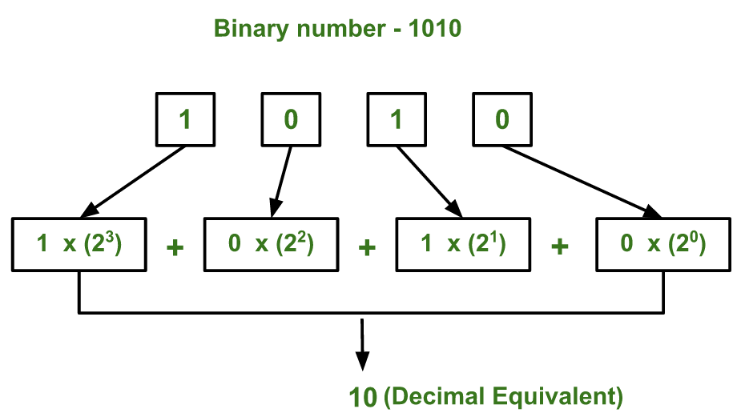
Number-base Conversions
Binary to Decimal Conversion
Start from the right most digit
Next, multiply this with the power of 2, and add the result.
Continue this process until there are no more digits left.
= 0 + 2 + 0 + 8 = 10

Slide 7
Number-base Conversions
Decimal | Binary | Hex
00 | 0000 | 0
01 | 0001 | 1
02 | 0010 | 2
03 | 0011 | 3
04 | 0100 | 4
05 | 0101 | 5
06 | 0110 | 6
07 | 0111 | 7
08 | 1000 | 8
09 | 1001 | 9
10 | 1010 | A
11 | 1011 | B
12 | 1100 | C
13 | 1101 | D
14 | 1110 | E
15 | 1111 | F

Slide 8
Signed numbers
1’s Complement
All ‘0’s become ‘1’s
All ‘1’s become ‘0’s
Example (10110000)₂
⇨ (01001111)₂
2’s Complement
Take 1’s complement then add 1
Toggle all bits to the left of the first ‘1’ from the right
Number: (10110000)₂
1’s Comp.: (01001111)₂
( 1)₂
2’s Comp.: (01010000)₂

Slide 9
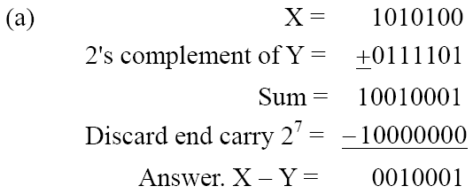
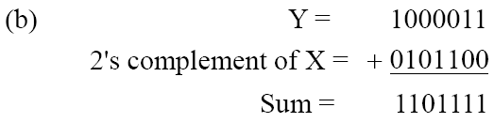
Signed numbers
Given the two binary numbers X = 1010100 and Y = 1000011, perform the subtraction (a) X – Y (b) Y - X , by using 2's complement.
There is no carry.
Therefore, the answer is
Y – X = − (2's complement of 1101111) = − 0010001.

Slide 10
Binary logic
Binary logic consists of binary variables and a set of logical operations.
The variables are designated by letters of the alphabet, such as A, B, C, x, y, z, etc, with each variable having two and only two distinct possible values: 1 and 0
Three basic logical operations: AND, OR, and NOT.

Slide 11
Binary logic
Truth Tables, Boolean Expressions, and Logic Gates
AND
OR
NOT
x | y | z
0 | 0 | 0
0 | 1 | 0
1 | 0 | 0
1 | 1 | 1
x | y | z
0 | 0 | 0
0 | 1 | 1
1 | 0 | 1
1 | 1 | 1
x | z
0 | 1
1 | 0
z = x • y = x y
z = x + y
z = x = x’

Slide 12
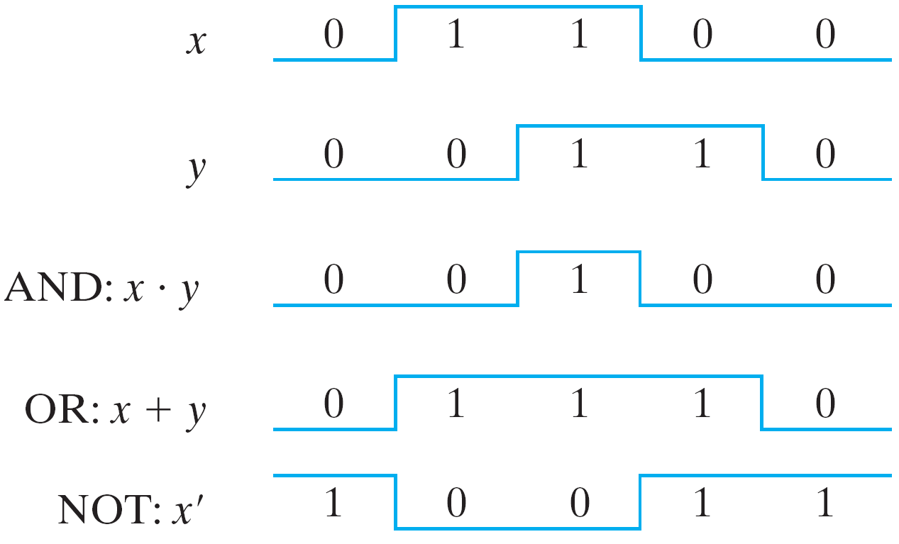
Binary logic
Input-Output signals for gates

Slide 13
Outline
Boolean Algebra
Boolean Functions
All Logic Gates
K-Map
Implementation with Logic Gates
Example : Parity Checking
Notes:
I will talk about xxx and yy

Slide 14
Boolean (binary) algebra
What is an algebra?
Mathematical system consisting of
Set of elements (example: N= {1,2,3,4,…})
Set of operators (+, -,×,÷)
Axioms or postulates (associativity, distributivity, closure, identityelements, etc.)
Why is it important?
Defines rules of “calculations”
Deals with binary variables and binary logic functions.
Has two discrete values
0, False, On
1, True, Off
Three basic logical operations
AND (.); OR (+); NOT (‘)
Notes:
it was mentioned in the previous lessondigital systems are discrete systems.
we have 3 main operations.

Slide 15
Boolean algebra – keywords
Literal: is a variable or its complement. ex: X, ~X, Y
Boolean Function: is a Boolean (binary) variable, which gets evaluated from logic computations involving Boolean variables and logic operators like ‘.’ AND ,’+’ OR, ‘’~’ NOT
Term: is a collection of Boolean variables formed by AND-ing or OR-ing, ex: ABC or (a+b)
Product Term: formed by AND-ing two or more Boolean variables. ex: ABC
Sum Term: formed by OR-ing two or more Boolean variables. ex: (a+b)
Sum of products: is the sum of product terms.
Canonical Form: It’s a function formed by min terms or max terms.
Min Term: It is a special product of literals, in which each input variable appears exactly once.
Max Term: It is a sum of literals , in which each input variable appears exactly once.
Truth Table: is a table that depicts the Boolean variable that has a value, 0 or 1.
Notes:
the words here are your dictionary. It consists of main words in logic design courses.

Slide 16
Boolean algebra – basic definitions
Associative Law: (x * y) * z = x * (y * z)
Commutative Law: x * y = y * x
Identity Element: e * x = x * e = x , x + 0 = 0 + x = 0 ,
Identity elements for (+) = 0 , (.) = 1
Complement (inverse): x * y = e , x + (-x) = 0
Distributive Law: x * (y . z) = (x * y) . (x * z)
* represents the binary operators like ‘.’ , ‘+’

Slide 17
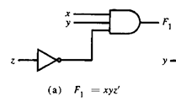
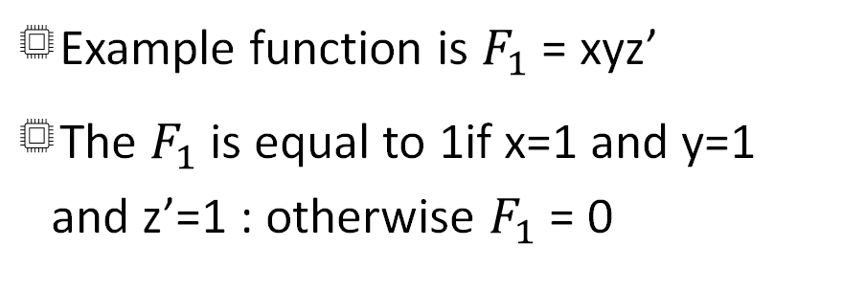
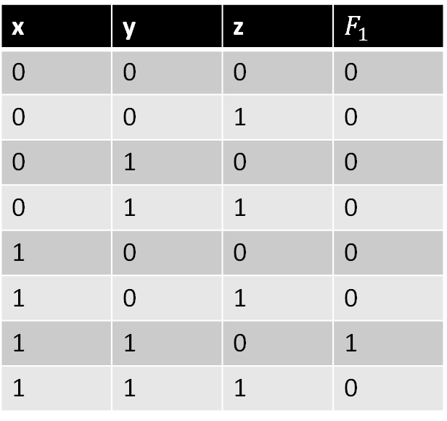
Boolean FUNCtions
Example function is $F_{1}$ = xyz’
The $F_{1}$ is equal to 1if x=1 and y=1 and z’=1 : otherwise $F_{1}$ = 0
x | y | z | $F_{1}$
0 | 0 | 0 | 0
0 | 0 | 1 | 0
0 | 1 | 0 | 0
0 | 1 | 1 | 0
1 | 0 | 0 | 0
1 | 0 | 1 | 0
1 | 1 | 0 | 1
1 | 1 | 1 | 0
Notes:
It was the intro so far. now we can work on an example.
there are 3 literals in this example.
how many logic operators are there? Just two. Actually ıts product term (andig).
First we have to start by create the truth table.
The truth table consists of cases where the given equation is 1 and 0.
Let's consider the design part. With which logical gates can we provide this equation?

Slide 18
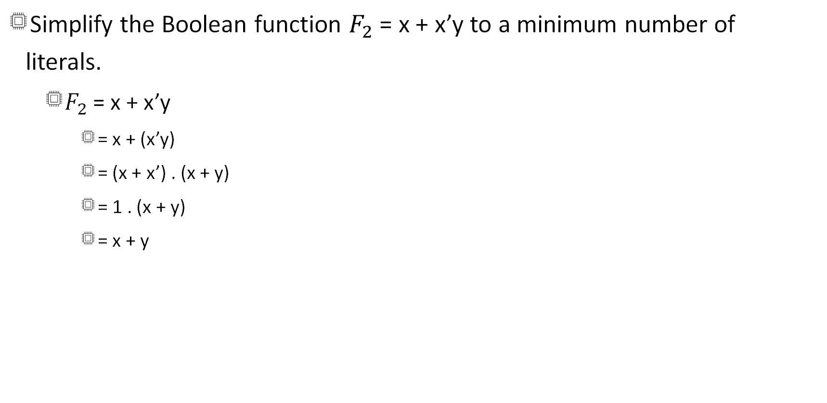
Boolean functions
Simplify the Boolean function $F_{2}$ = x + x’y to a minimum number of literals.
$F_{2}$ = x + x’y
= x + (x’y)
= (x + x’) . (x + y)
= 1 . (x + y)
= x + y

Slide 19
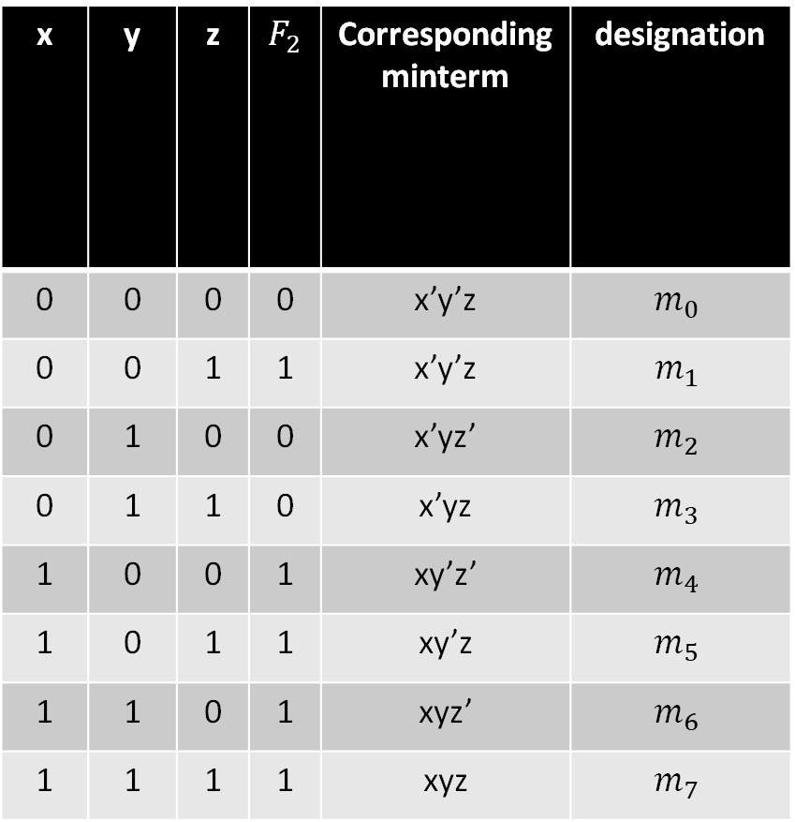
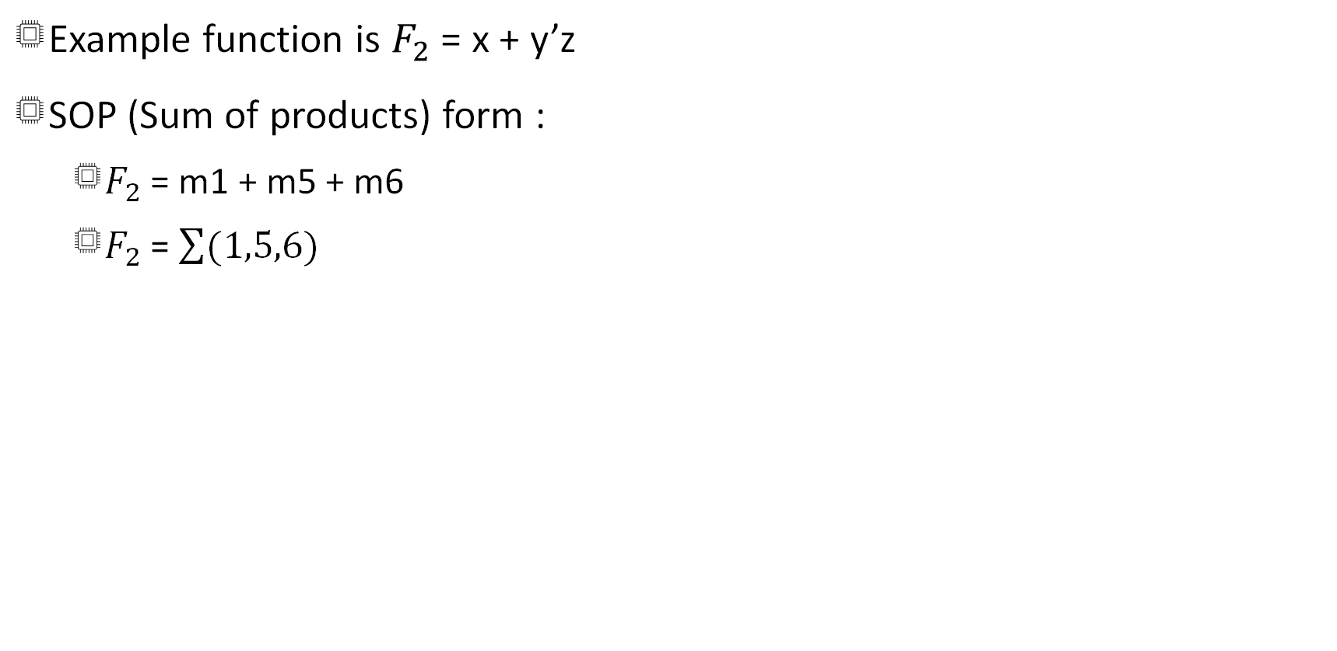
Boolean functions
x | y | z | $F_{2}$ | Corresponding minterm | designation
0 | 0 | 0 | 0 | x’y’z | $$m_{0}$$
0 | 0 | 1 | 1 | x’y’z | $$m_{1}$$
0 | 1 | 0 | 0 | x’yz’ | $$m_{2}$$
0 | 1 | 1 | 0 | x’yz | $$m_{3}$$
1 | 0 | 0 | 1 | xy’z’ | $$m_{4}$$
1 | 0 | 1 | 1 | xy’z | $$m_{5}$$
1 | 1 | 0 | 1 | xyz’ | $$m_{6}$$
1 | 1 | 1 | 1 | xyz | $$m_{7}$$
Example function is $F_{2}$ = x + y’z
SOP (Sum of products) form :
$F_{2}$ = m1 + m5 + m6
$F_{2}$ = $\sum{(1,5,6)}$

Slide 20
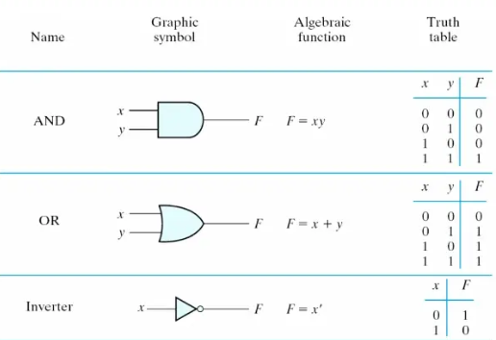
SUMMary of Logic gates

Slide 21
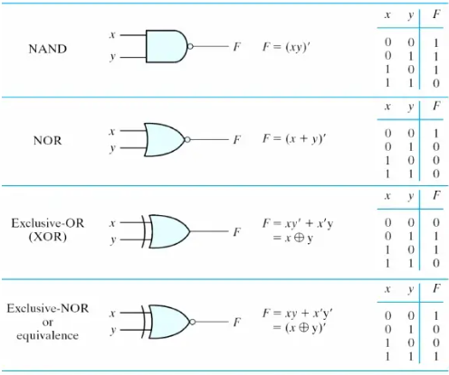
SUMMary of Logic gates

Slide 22
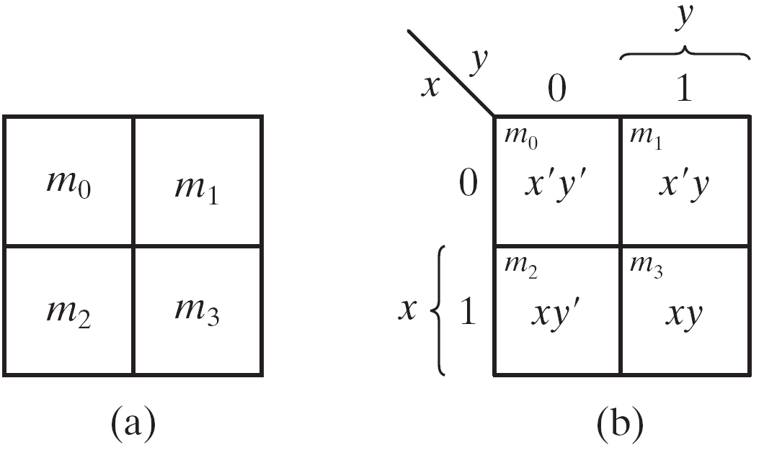
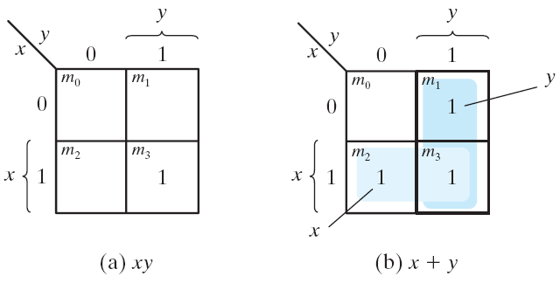
Karnaugh Map ( K-map)
The k-map use for a logic minimization.
Two-variable Map
Representation of functions in the map

Slide 23
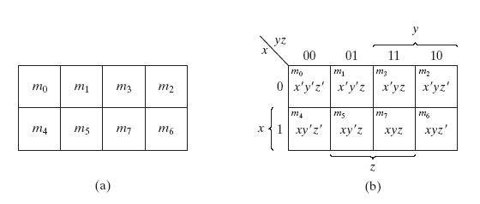
Karnaugh Map ( K-map)
Three-variable Map

Slide 24
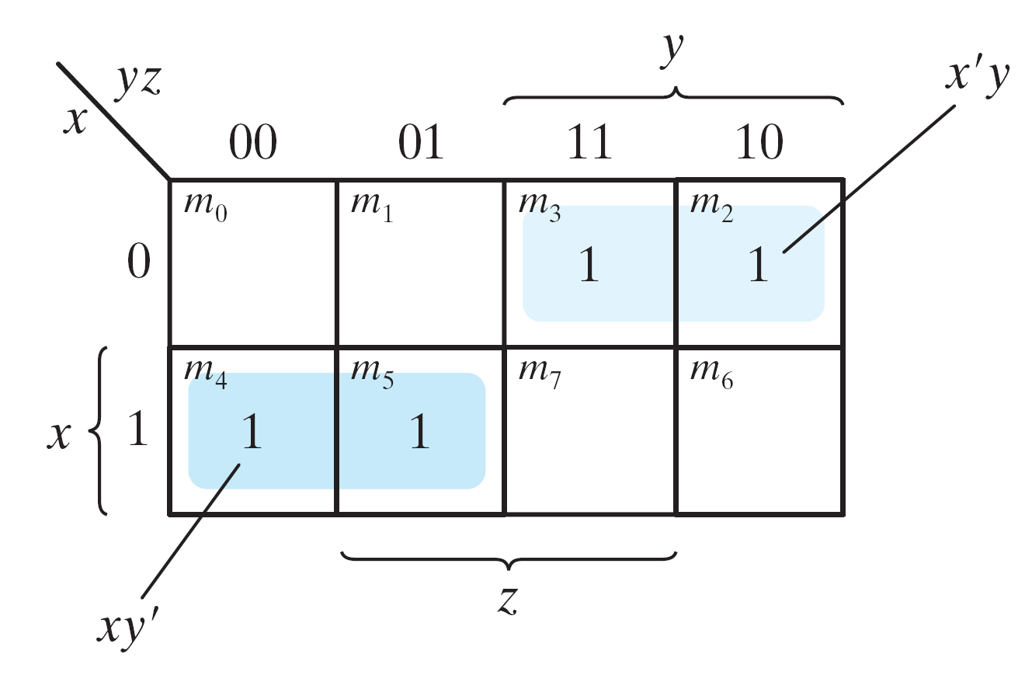
Karnaugh Map ( K-map)
Example: simplify the Boolean function F(x, y, z) = Σ(2, 3, 4, 5)
F(x, y, z) = Σ(2, 3, 4, 5)
= x'y + xy’
= x⊕y

Slide 25
Parity checking
The problem is to show how many ones (1s) a given number contains by looking at its bits. The given number is 3-bits.
Draw truth table
Write logic equation
P = Σ(1, 2, 4, 7)
x | y | z | P
0 | 0 | 0 | 0
0 | 0 | 1 | 1
0 | 1 | 0 | 1
0 | 1 | 1 | 0
1 | 0 | 0 | 1
1 | 0 | 1 | 0
1 | 1 | 0 | 0
1 | 1 | 1 | 1

Slide 26
Parity checking
If the given number contains an odd number of 1s the P is True. The given number is 3-bits.
Draw truth table & write logic equation
Simplify the equation with K-map
P = x ⊕ y ⊕ z
1
1
1
1

Slide 27
Digital Design Primer
FPGA/Verilog from Scratch
DAY 1 - LAB

Slide 28
Outline
Hierarchical Design
Verilog Introduction
Structural Verilog
Lab exercises

Slide 29
Hierarchical Design
Circuits are too complex for us to design all the detail at once.
Design subsystems for simple functions.
Compose subsystems to form the system
Treating subcircuits as “black box” components
Verify independently, then verify the composition
Topdown/bottomDigital Design Methodology — up design

Slide 30
Summary
Digital systems use discrete (binary) representations of information.
Basic components: gates and flipflops
Combinational and sequential circuits
Real─ world constraints
logic levels, loads, timing, area, etc
Verilog models: structural, behavioral
Design methodology
Think
Draw diagrams
Write Verilog
Test it

Slide 31
verilog
Hardware Description Language (HDL)
A computer language for modeling behavior and structure of digital systems
Verilog published in 1983, strong similarities to C.
Electronic Design Automation (EDA) using Verilog
Design entry: alternative to schematics
Verification: simulation, proof of properties
Synthesis: automatic generation of circuits

Slide 32
Module definition
A module is the main building block in Verilog
We first need to declare:
Name of module
Types of connections (inps , outps)
Names of its connections
A
B
C
Verilog Module
Y

Slide 33
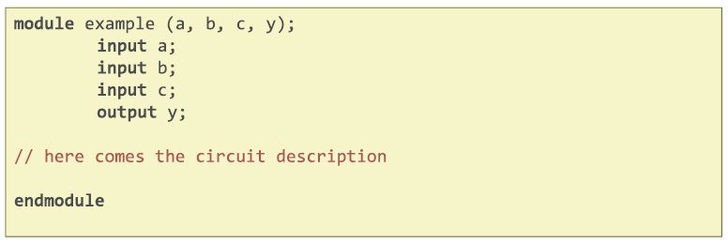
Module definition
A
B
C
Verilog Module
Y

Slide 34
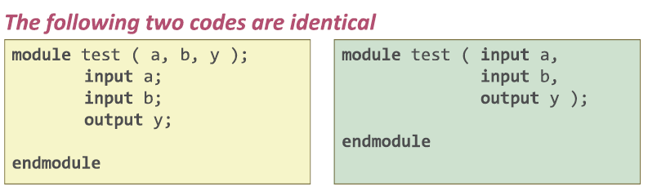

Module definition
Positional association (implicit): parameters listed in the same order as the original module description
Explicit association: parameters explicitly listed in the arbitrary order.

Slide 35
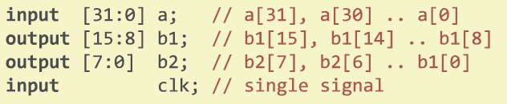
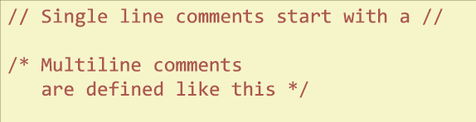
Verilog Syntax
Verilog is case sensitive: somename and SomeName are not the same!
Names can not start with numbers.
Whitespace is ignored.
Definition of multi-bits:

Slide 36
Verilog Syntax
Use MSB to LSB ordering for busses (little-endian)
A[31:0]
Define one module per file
Makes managing your design hierarchy easier
Use a file name that equals module name
Develop/use a consistent naming style

Slide 37
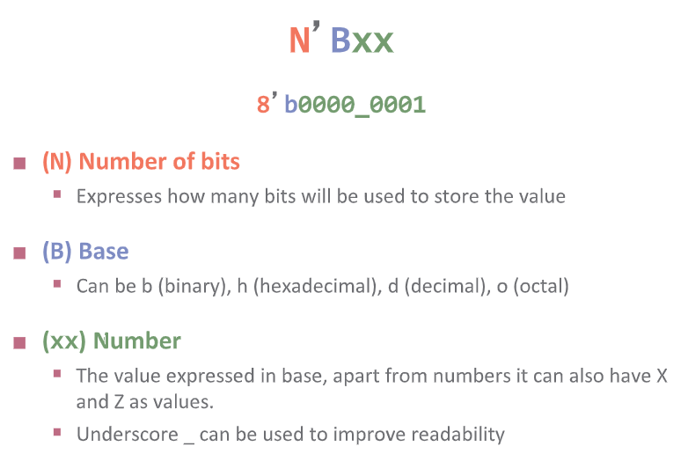
Number representation

Slide 38
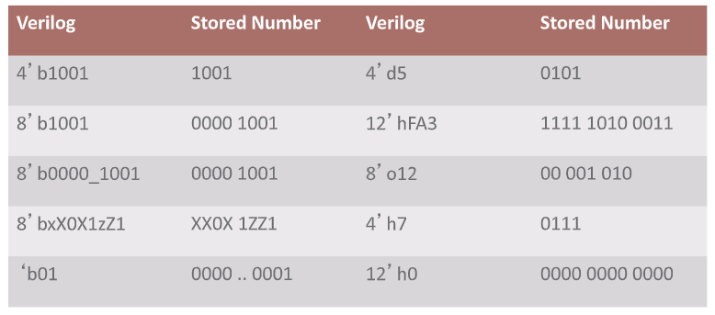
Number representation

Slide 39
Data types
Nets connect components and are continuoly assigned values
Wire is main net type
Variables store values between assignments
Reg is main variable type
Scalar is a single value, usually one bit
Logic values: 0, 1, x (undefined state), z (tri-state/high impedance)

Slide 40
Styles of verilog
Structural
Describe how modules are interconnected
Each module contains other modules (instances/submodules)
Describes a hierarchy
Behavioral
The module body contains functional description of the circuit
Contains logical and mathematical operators
Practical circuits would use a combination of both!

Slide 41
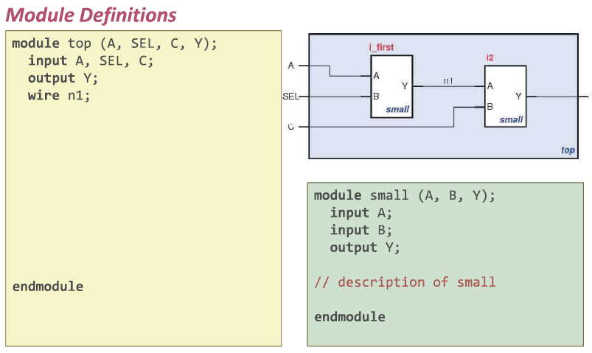
Structural verilog

Slide 42
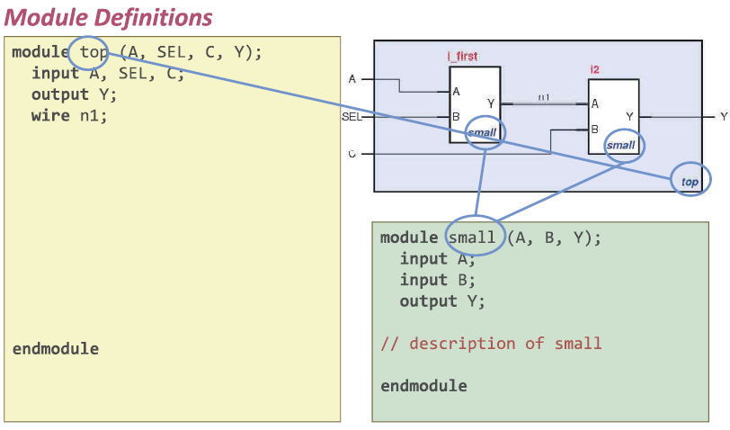
Structural verilog

Slide 43
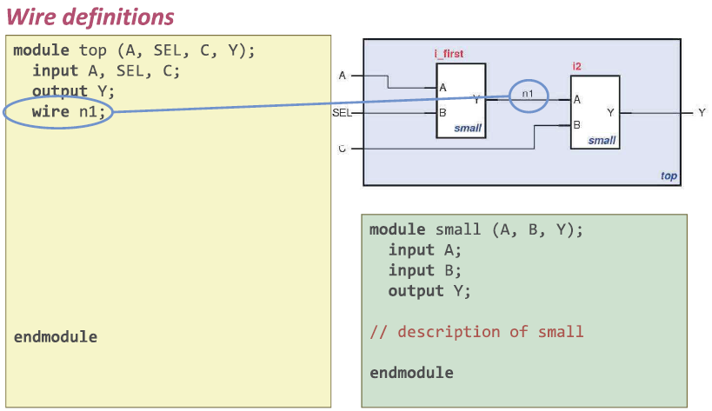
Structural verilog

Slide 44
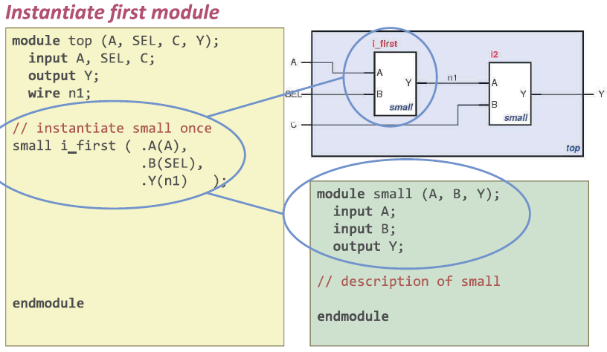
Structural verilog

Slide 45
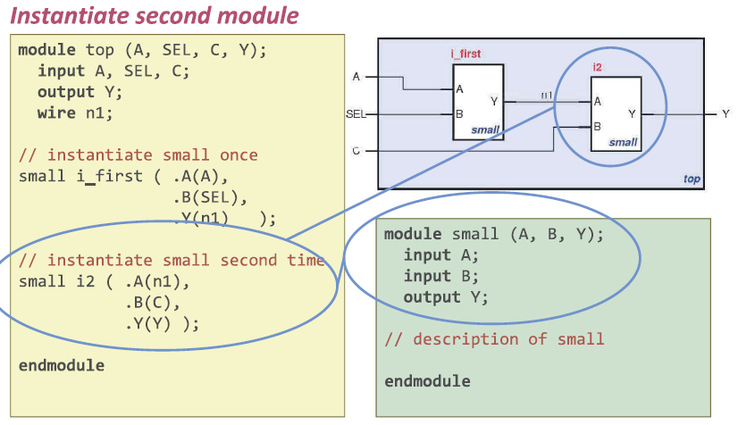
Structural verilog

Slide 46
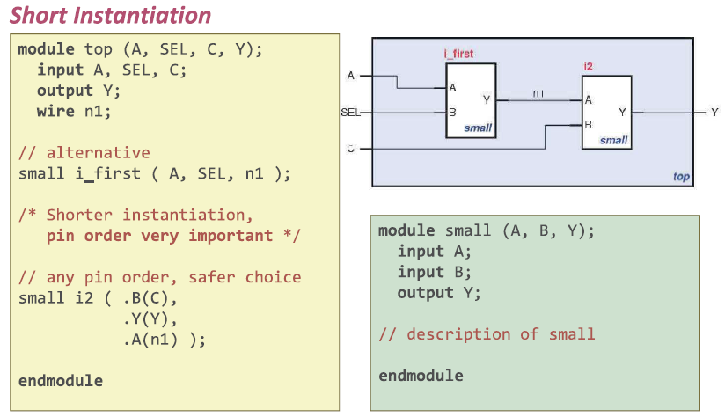
Structural verilog

Slide 47
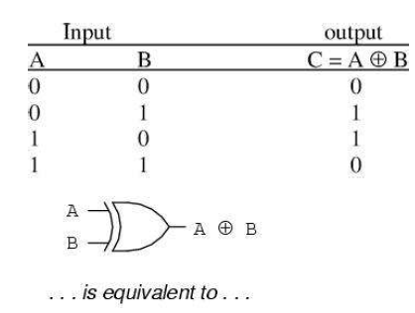
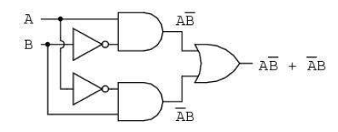
Structural verilog

Slide 48
Testing on fpga board
Pay attention to the places marked with yellow.
Before we put it on the FPGA board, we need to specify which pins our inputs & outputs are connected to.
We have to perform the appropriate assignments from the pin planner using the user manual.
Main module (wants to run) select as a top module.

Slide 49
Testing on fpga board
Led-switch example
One-two gates example

